Slide 1

MY HOUSE RUNS .NET
Smart Home Automation with .NET Core and Azure
Senior Content Developer, Microsoft

Slide 2
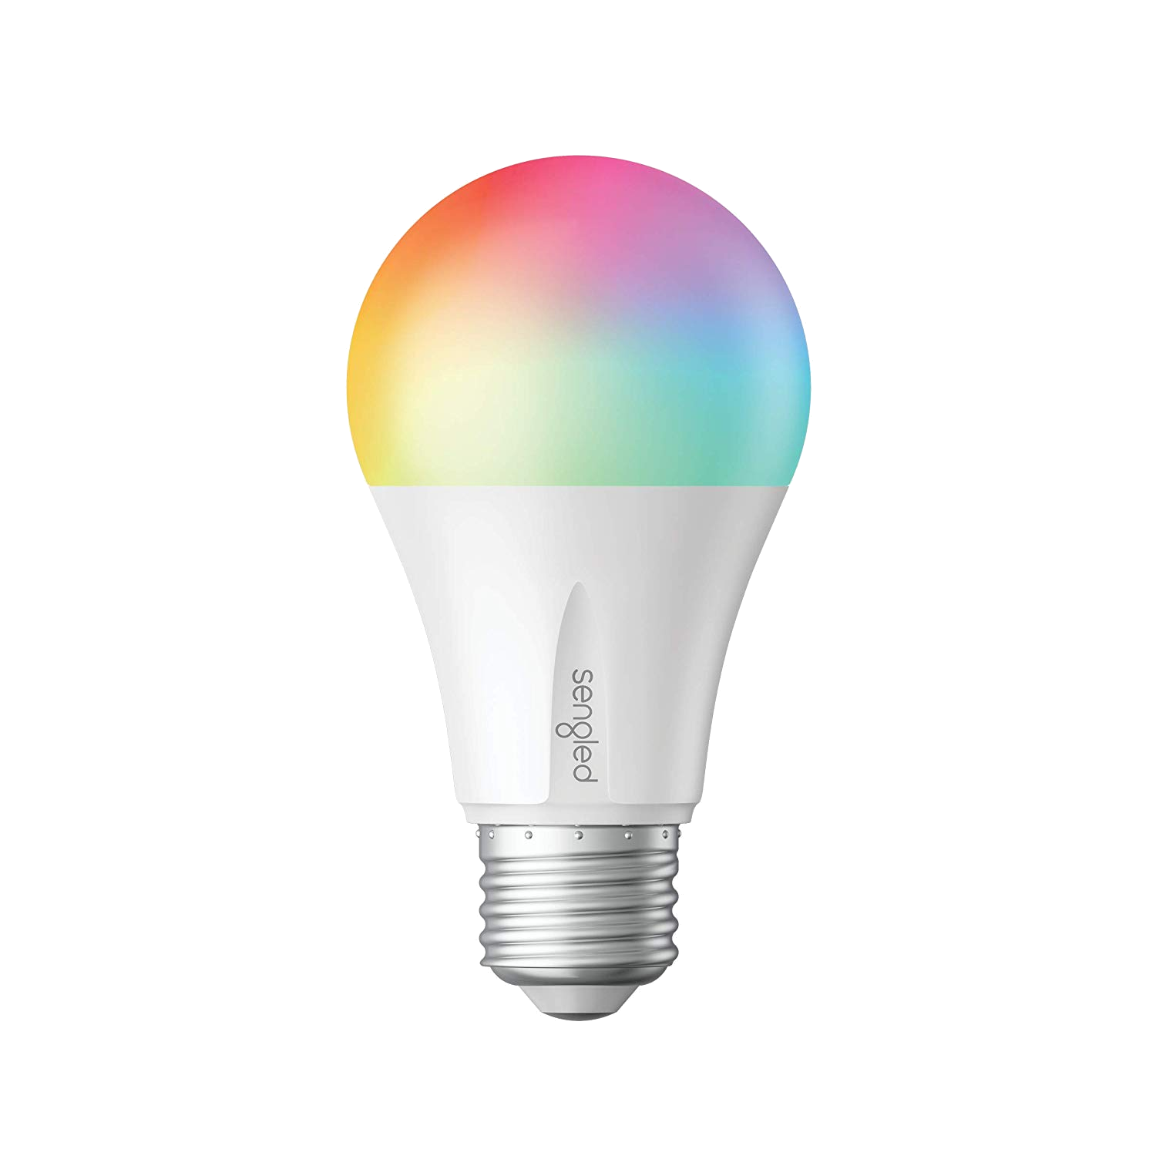
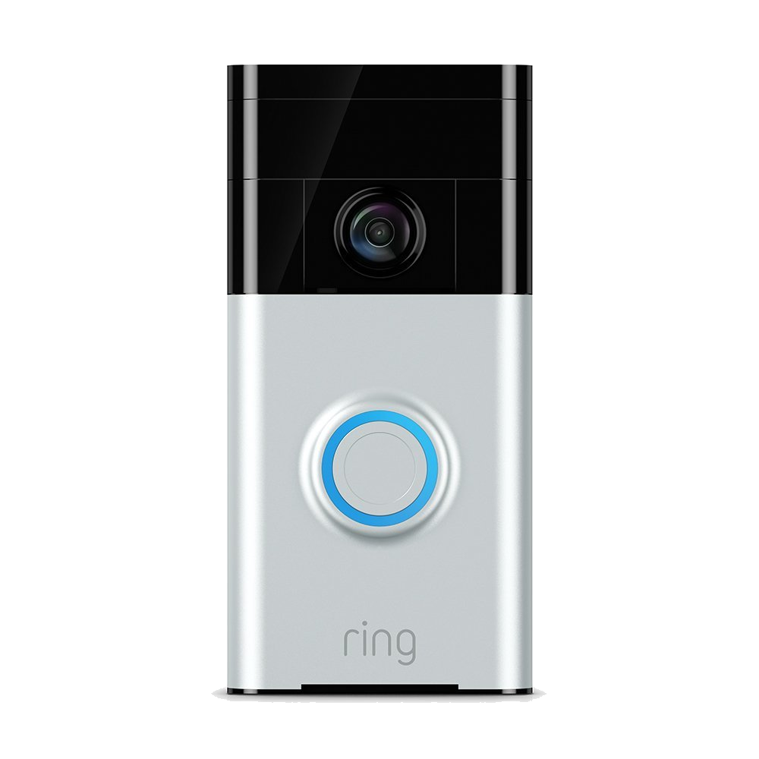
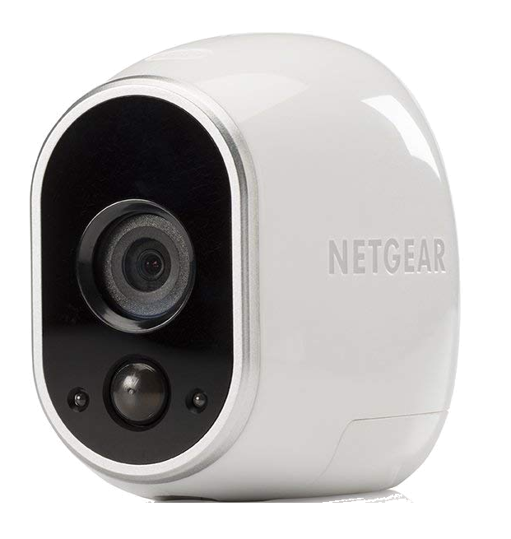
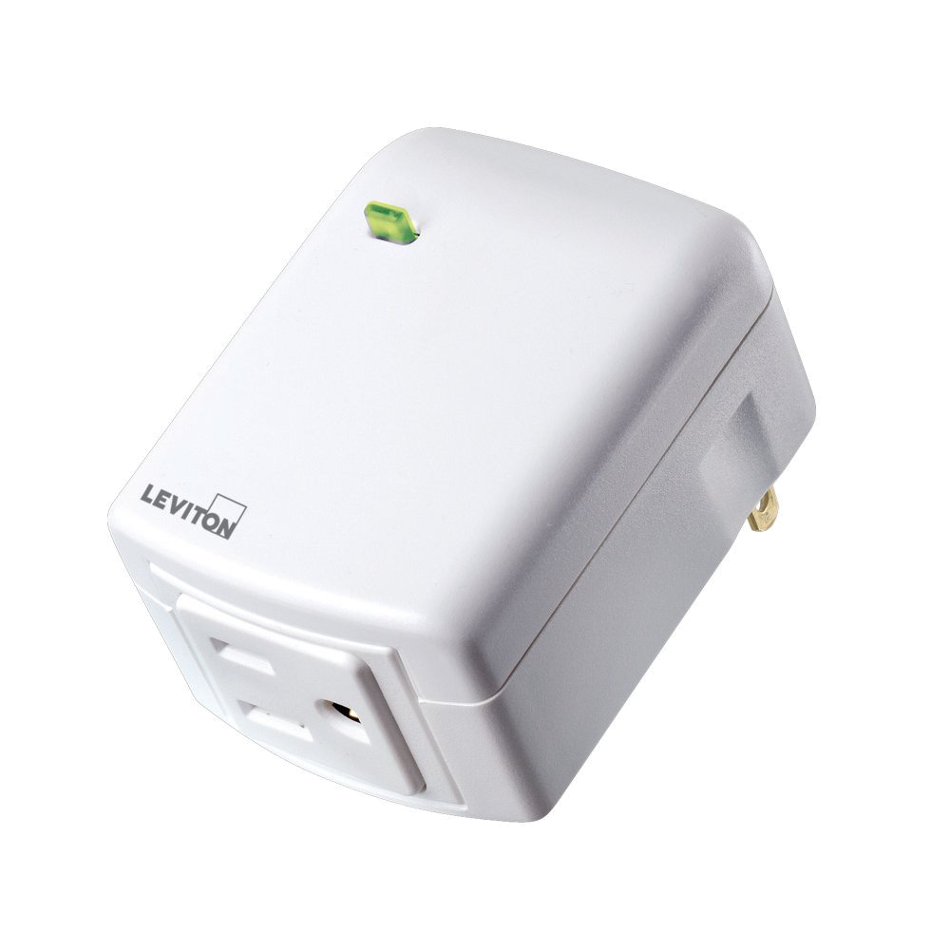
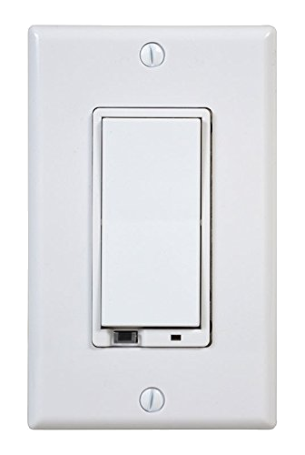
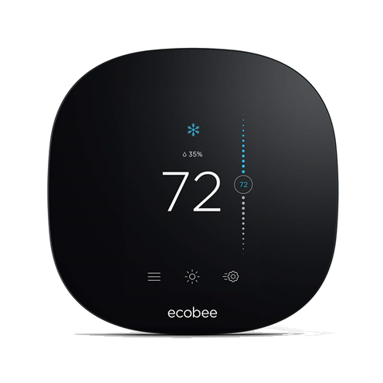
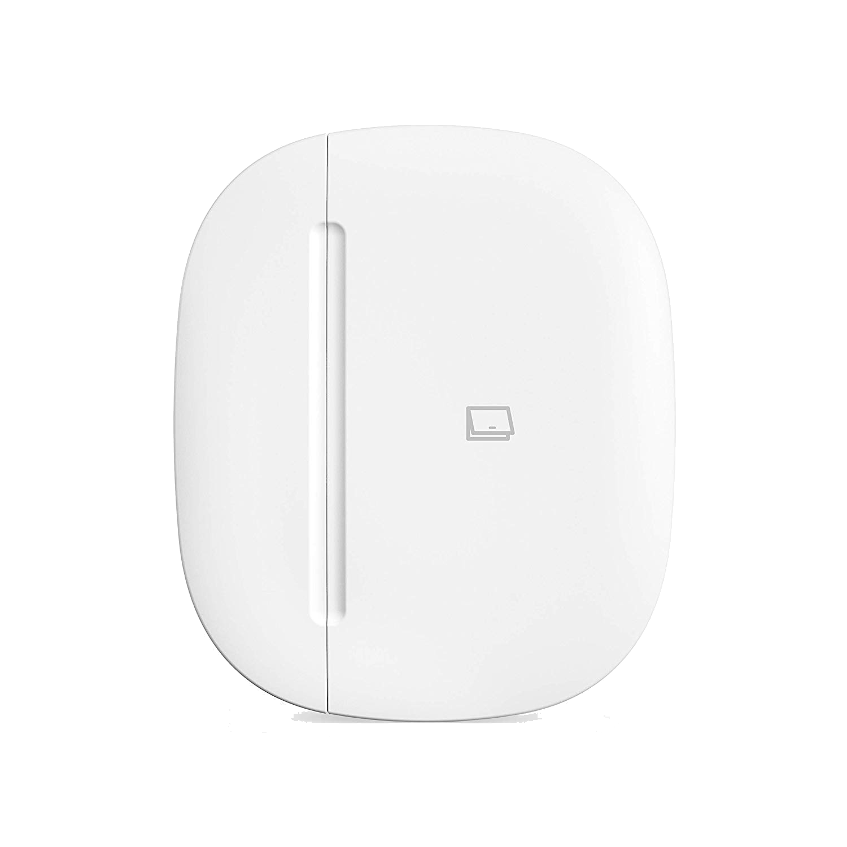
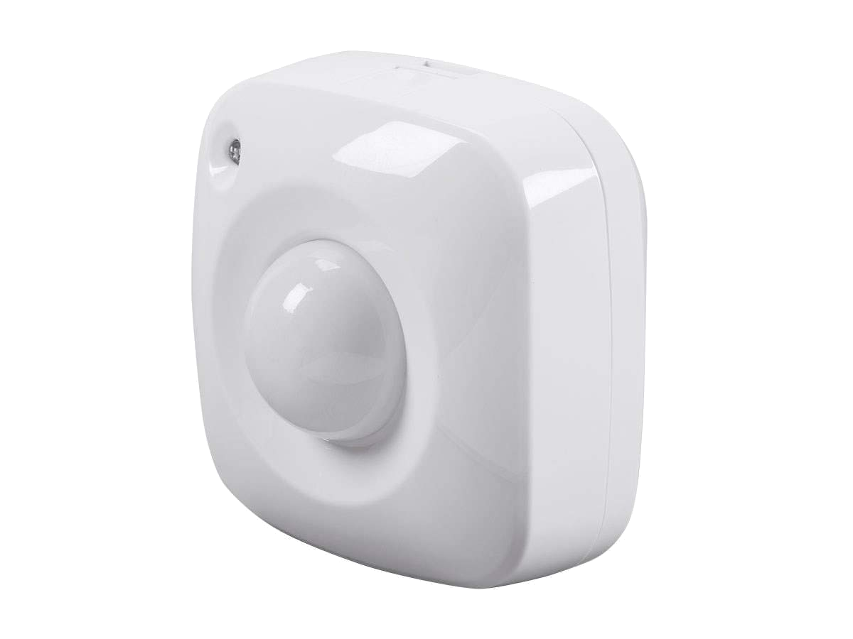

Slide 3

Why you want a home automation hub
Integrates TCP/IP, Z-Wave, and Zigbee
Centralized automation in response to:
Time
Presence
Sensors
AI assistant integration
Remote access
API

Slide 4
I chose Samsung SmartThings…
Pros:
Market support
Open source community
GitHub integration
Cons:
Obscure programming language
Tooling
No debugging
Cloud execution

Slide 5
…but then migrated to Hubitat Elevate
Pros:
Similarity to SmartThings
Local execution
Cons:
Similarity to SmartThings
Porting code from SmartThings

Slide 6
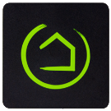
Hubitat Elevate
Pros:
Integrates TCP/IP, Z-Wave, and Zigbee devices
SmartThings similarity
Broad market support
Open source community
Local execution
Easy RESTful API
Cons:
Obscure programming language
Tooling
No debugging

Slide 7

Hubitat Elevate’s super easy API
Notes:
Demo Maker API and Event Socket

Slide 8
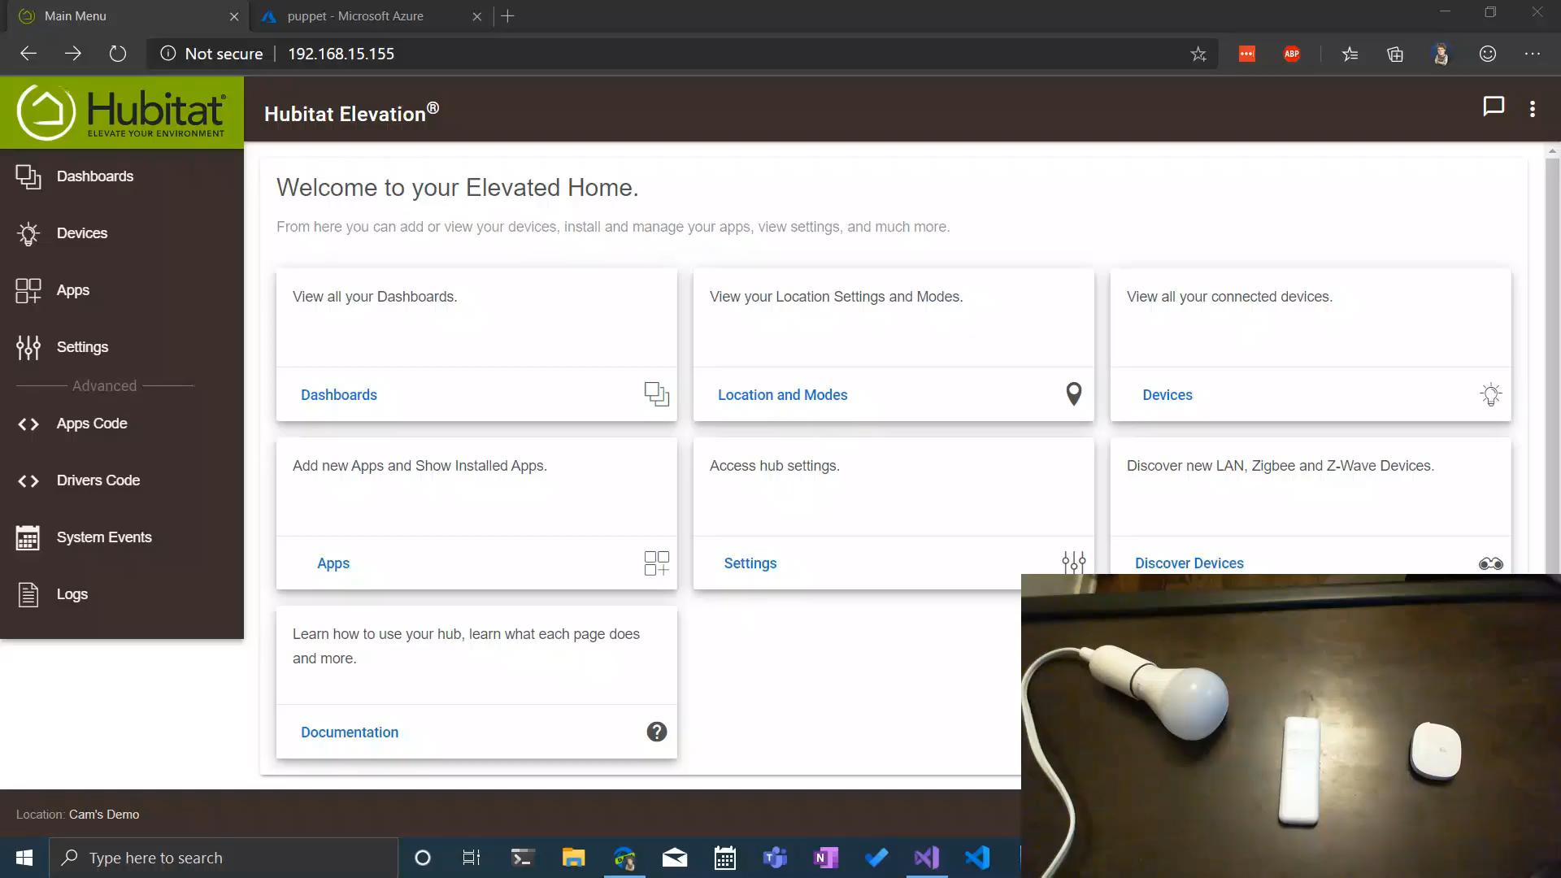

Slide 9
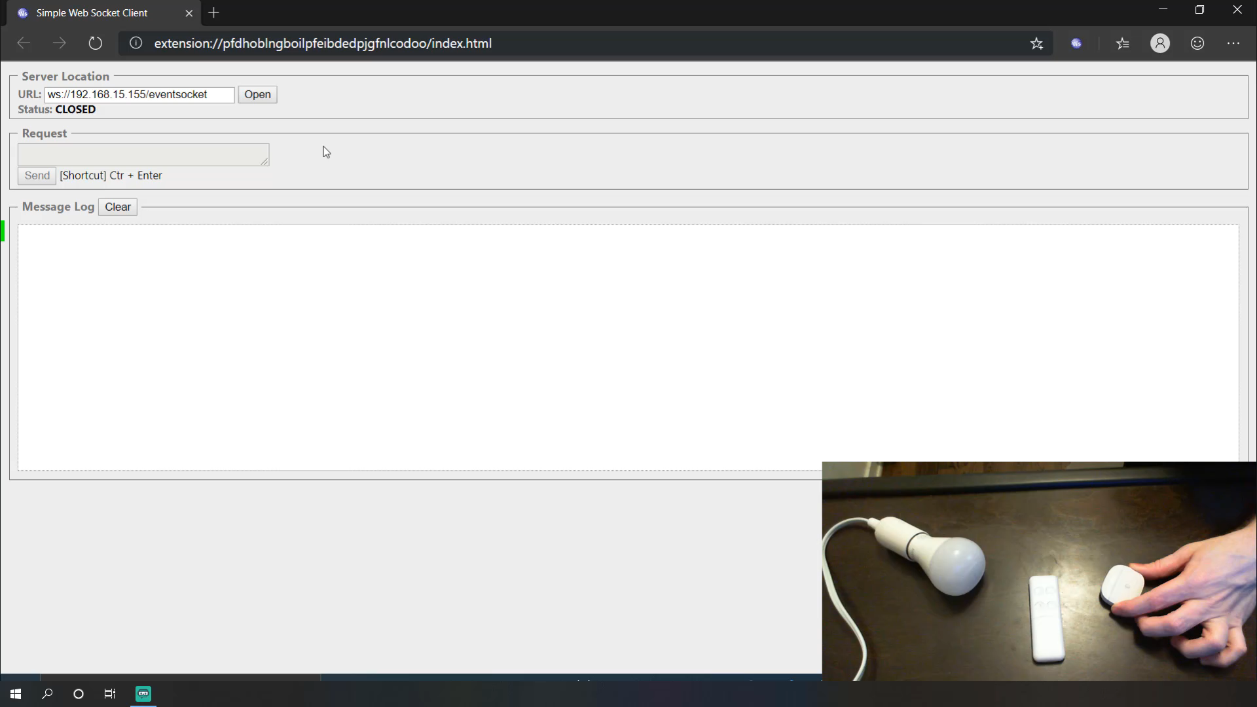

Slide 10

Inspiration struck!
Notes:
I realized that I could use .NET Core to build a framework around the Maker API and Event Socket. This would enable me to use .NET’s mature tools like Visual Studio, give me full debugging support, enable me to consume NuGet packages, and give me a platform on which I could build anything I could imagine.

Slide 11

PUPPET
Notes:
I realized that I could use .NET Core to build a framework around the Maker API and Event Socket. This would enable me to use .NET’s mature tools like Visual Studio, give me full debugging support, enable me to consume NuGet packages, and give me a platform on which I could build anything I could imagine.

Slide 12


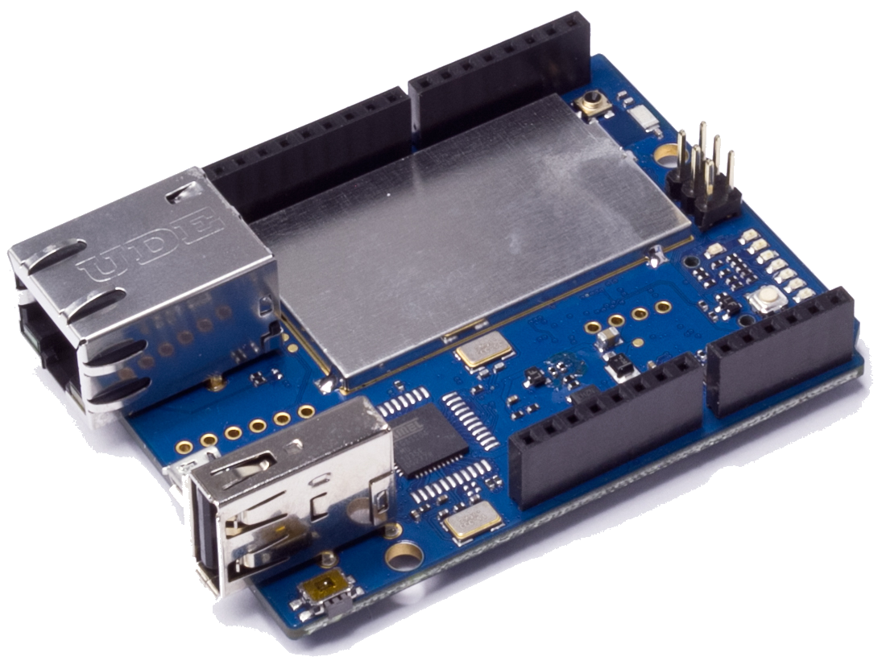
Front Door: open
Front Door: close
Puppet
Puppet.Automation.FrontDoorStuff
WebSocket

Slide 13
Building a garage door module
Values
open
Closed
Opening
closing
Commands
open()
close()

Slide 14
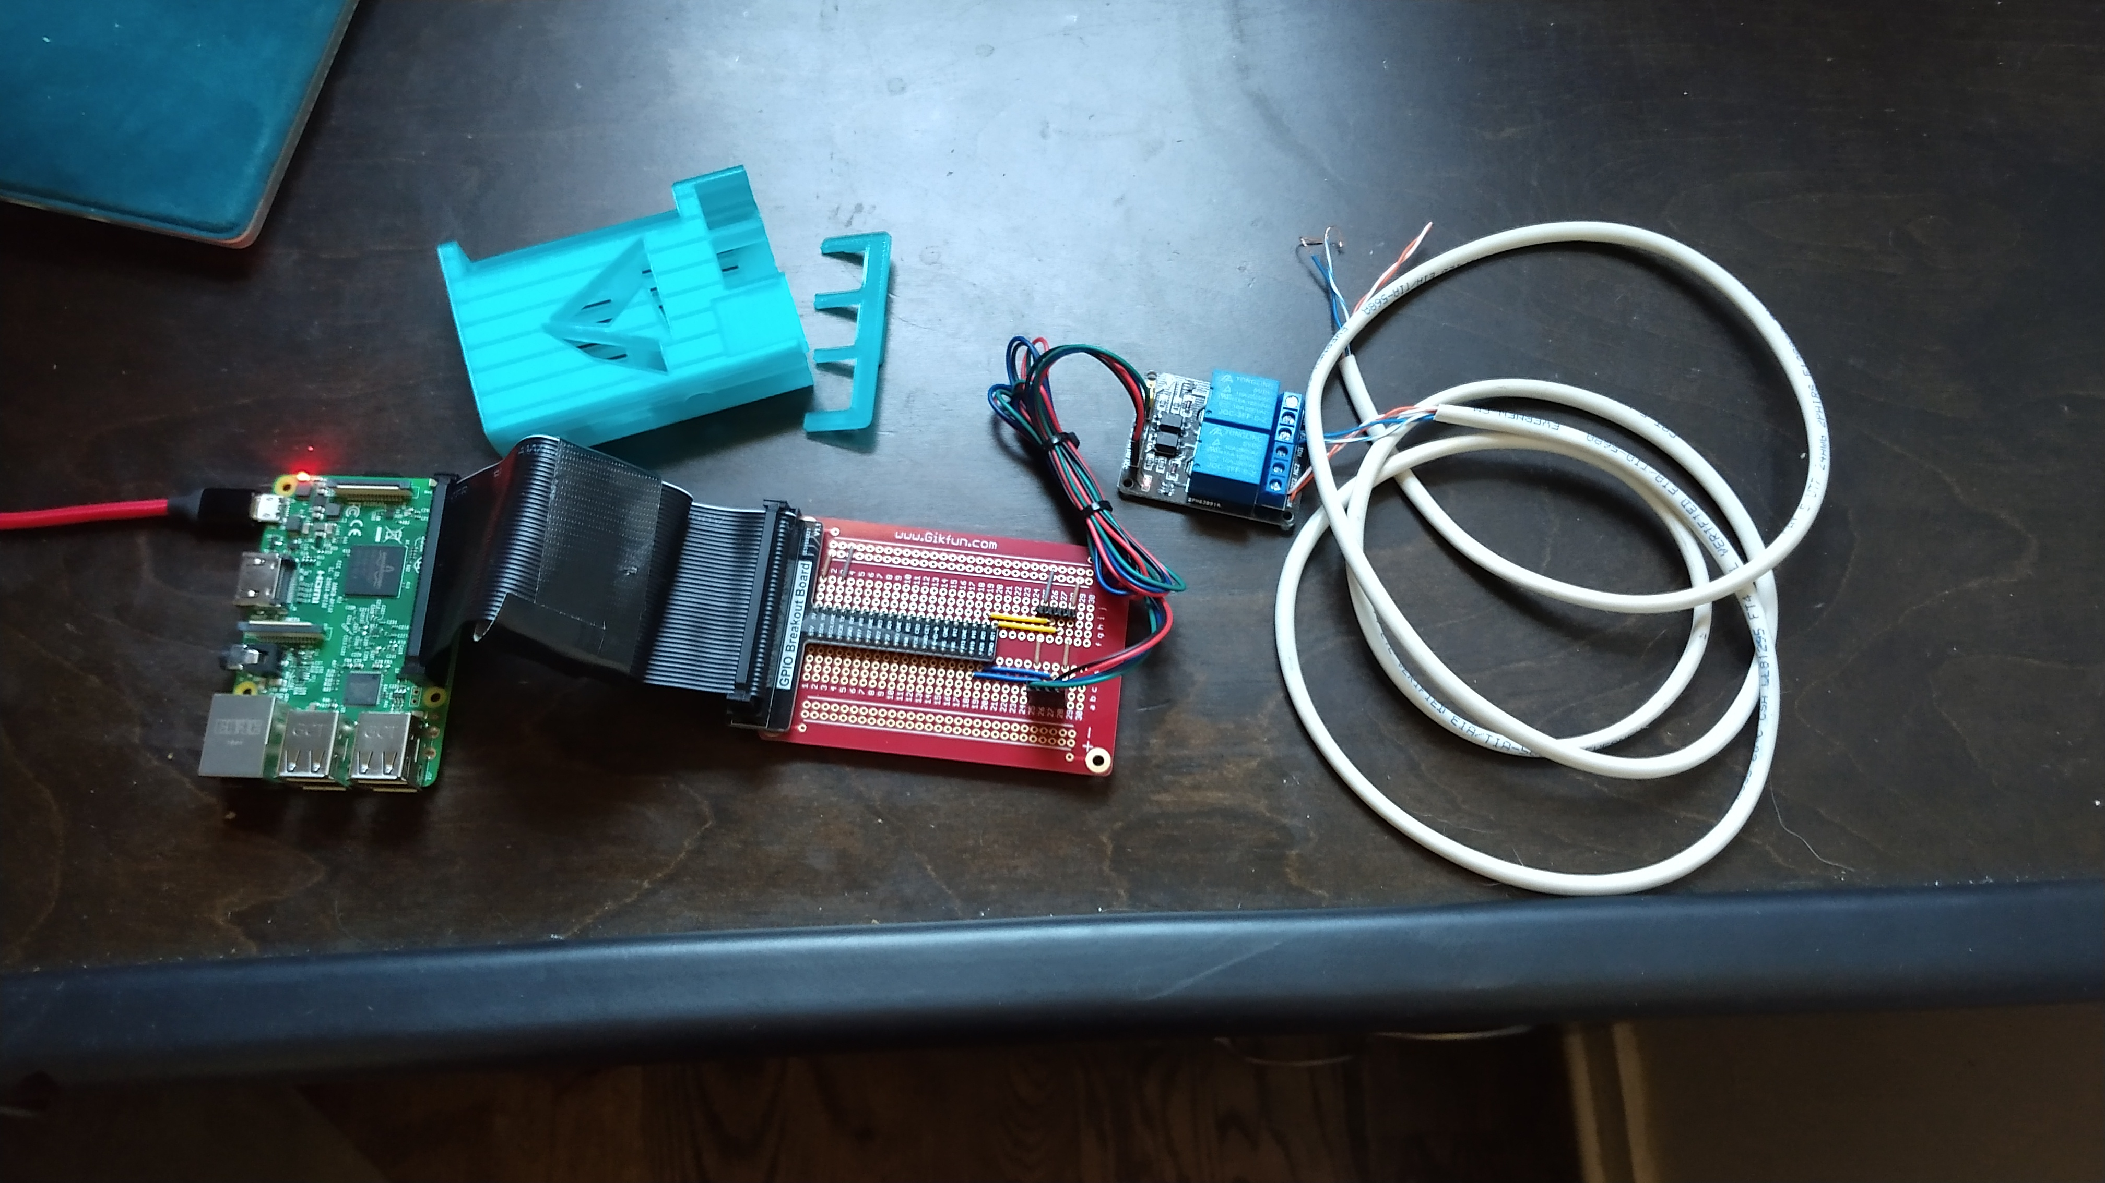

Slide 15
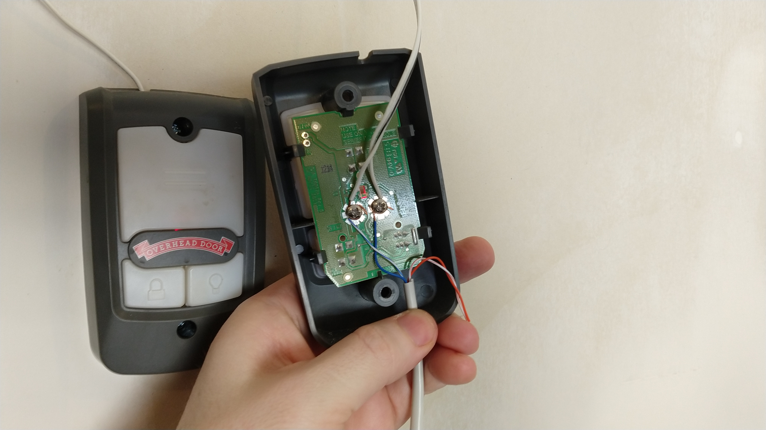

Slide 16
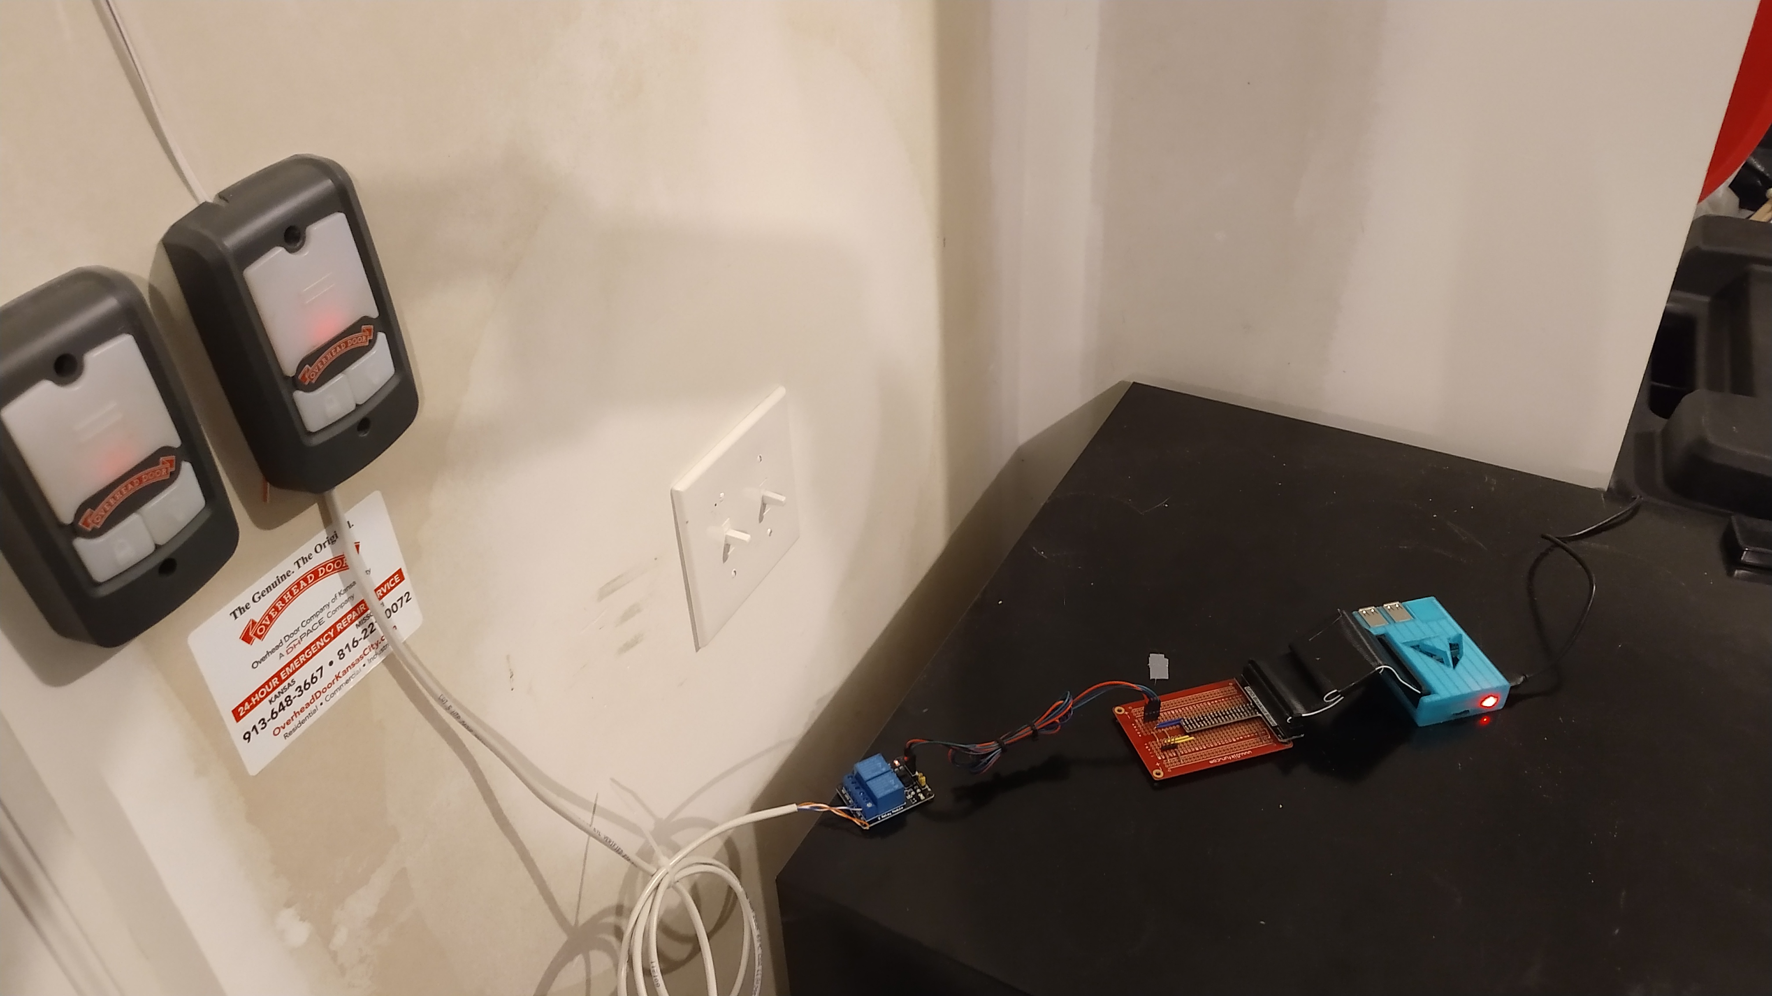

Slide 17
close()
Virtual Garage Door
CLOSING
CLOSED
OPEN
Puppet
Contact Sensor
CLOSED
OPEN

Slide 18




@CamSoper CamSoper
http://github.com/CamSoper/puppet

